Slide 1
Analysis of Frames and Machines
Dr. Jacob Moore
Associate Professor of Engineering
Penn State Mont Alto

Slide 2
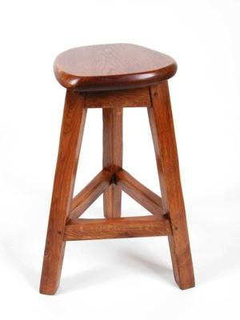
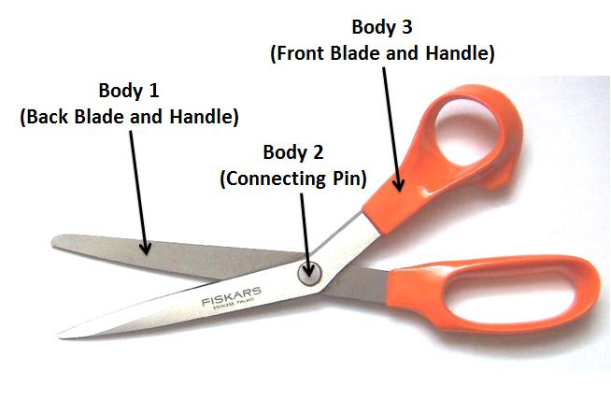
Frames and Machines
A frame or machine is a type of engineering structure where at least one member is not a two-force member. This member will have forces acting on it in three or more locations

Slide 3
Analysis of Frames and Machines
The analysis of Frames and Machines works on the following assumptions.
The structure you are analyzing is in static equilibrium. If it is independently rigid, then we can analyze the whole structure to find the external reaction forces.
Each component in the structure you are analyzing is also in static equilibrium and can be analyzed as a separate rigid body to find the forces acting on it.
Whenever two components are connected, there will be equal and opposite forces acting on each component at that connection point (in the form of a Newton’s Third Law pair).

Slide 4
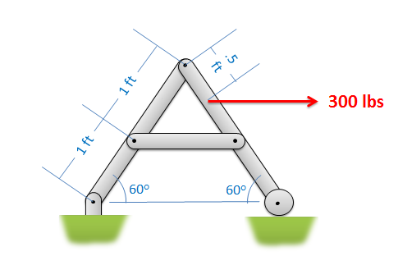
The Analysis of Frames and Machines
Step 1: Label the joints of the members of your frame or machine and…
Determine if the frame or machine is independently rigid
Determine which members are two force members.
C
B
D
A
E

Slide 5
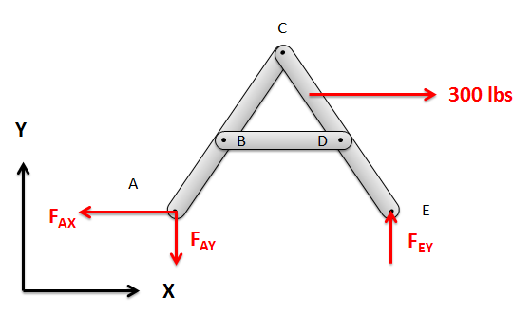
The Analysis of Frames and Machines
Step 2 (sometimes): If and only if a frame is independently rigid, treat the whole structure as a rigid body and solve for the external reaction forces.

Slide 6
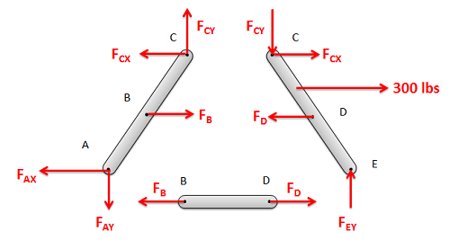
The Analysis of Frames and Machines
Step 3: Separate the members of the structure and draw a free body diagram of each member.
You will be guessing the direction of most forces, but…
Remember that bodies in contact exert equal and opposite forces on each other.
Two-force members will exert forces in a known direction.

Slide 7
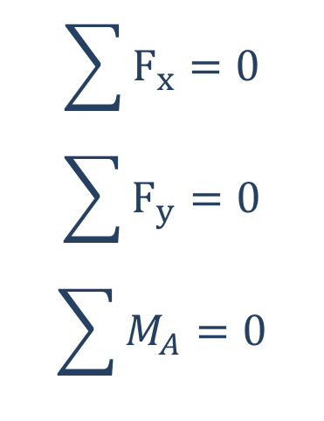
The Analysis of Frames and Machines
Step 4: Write out the equilibrium equations for each component.
You may have more than three unknowns for any one component, and that’s fine as long as the total number of unknowns is less than or equal to the total number of equations you generate (three equations per component).
$$\sum{F_{x}}=0$$
$$\sum{F_{y}}=0$$
$$\sum{M_{A}}=0$$

Slide 8
The Analysis of Frames and Machines
Step 5: Solve the equilibrium equations for the unknown forces.
If you wind up with a negative number, the direction of the force is opposite of what was shown in your free body diagram.
Use computer tools if you have a large number of equations and unknowns
$$\sum{F_{x}}=0$$
$$\sum{F_{y}}=0$$
$$\sum{M_{A}}=0$$

Slide 9
Solutions for Frame and Machine Problems
Unlike trusses, we can’t just list the magnitude of forces (with tension and compression) for the individual members for a solution, we will need to be more specific because the situation is more complex.
We can’t even list a magnitude and direction since most forces come in pairs.
The best way to show all the forces acting on the components is to draw all the components in a second free body diagram with the known magnitudes and known directions drawn on each component individually.
30 lbs
50 lbs
A
100 lbs
B
50 lbs
C
30 lbs

Slide 10
Thanks for Watching
See other engineering mechanics videos and access the full tool at…

Slide 11
Analysis of Frames and Machines Worked Example
Identify all forces acting on the members of the frame shown in the situation below.
C
B
D
A
E

Slide 12
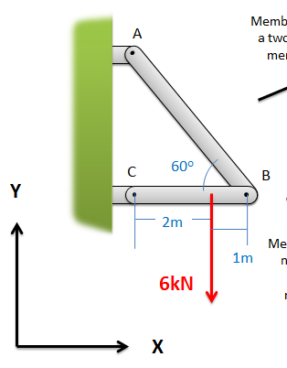
Analysis of Frames and Machines Worked Example
Identify all forces acting on the members of the frame shown in the situation below.

Slide 13
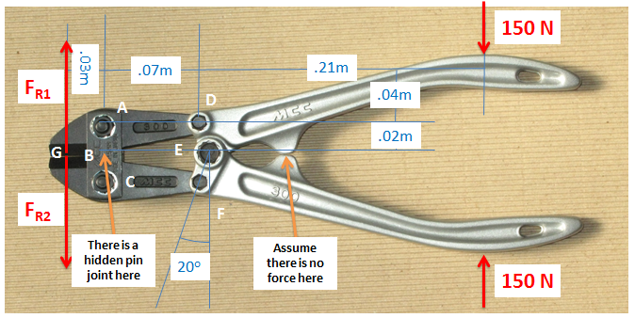
Analysis of Frames and Machines Worked Example
Find the cutting forces (F_{R1} and F_{R2} ) that the bolt cutter exerts

Slide 14
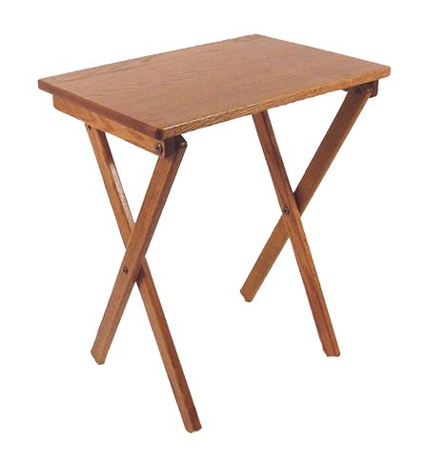
Analysis of Frames and Machines Worked Example
The TV tray shown below has a maximum rated load of 100 lbs. Lets determine the forces acting on each of the legs for the following setup, which is likely the limiting scenario (assume no friction at base).
100 lbs
1 ft
1 ft
1.5 ft
1.5 ft
2 ft

